Slide 1
Unified Database with Filterable Dashboard
Team Members:
Javier Velasco
Mohamed Eltanani
Suraj Shetty
Sonia Alcantara Tuscano
Kristen Locke

Slide 2
Test Scenario
Test Case 1 : Inserting Record in HR_MASTER table from INS_HR_MASTER TABLE by running a program.
Test Case 2 : Updating Record in HR_MASTER table from INS_HR_MASTER TABLE by running a program.

Slide 3
Test Case 1
Insert record in Ins_Hr_Master table
Run program to insert record in Hr_Master table
Check Hr_Master table

Slide 4
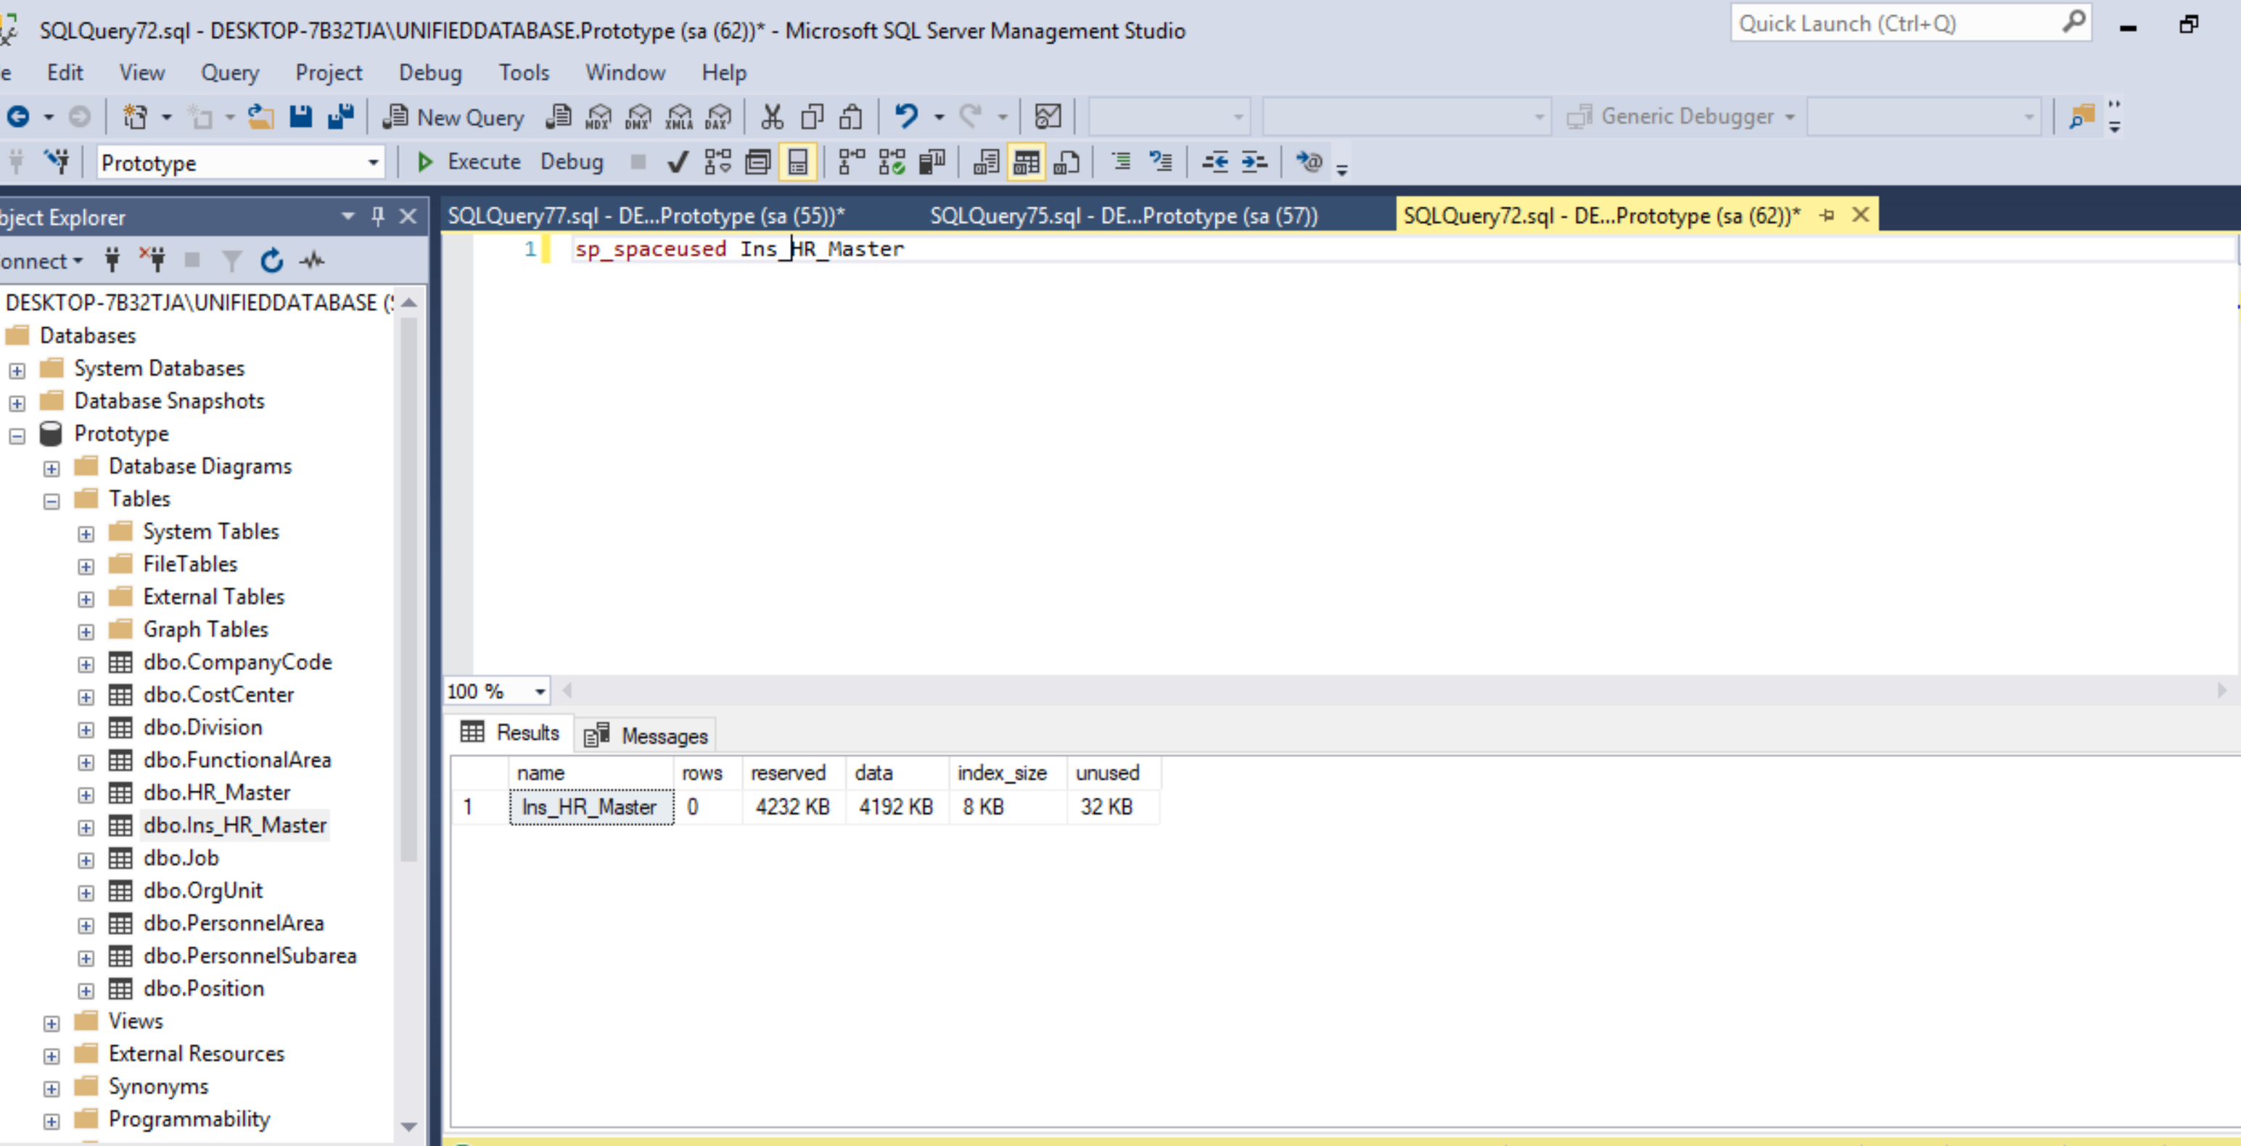

Slide 5
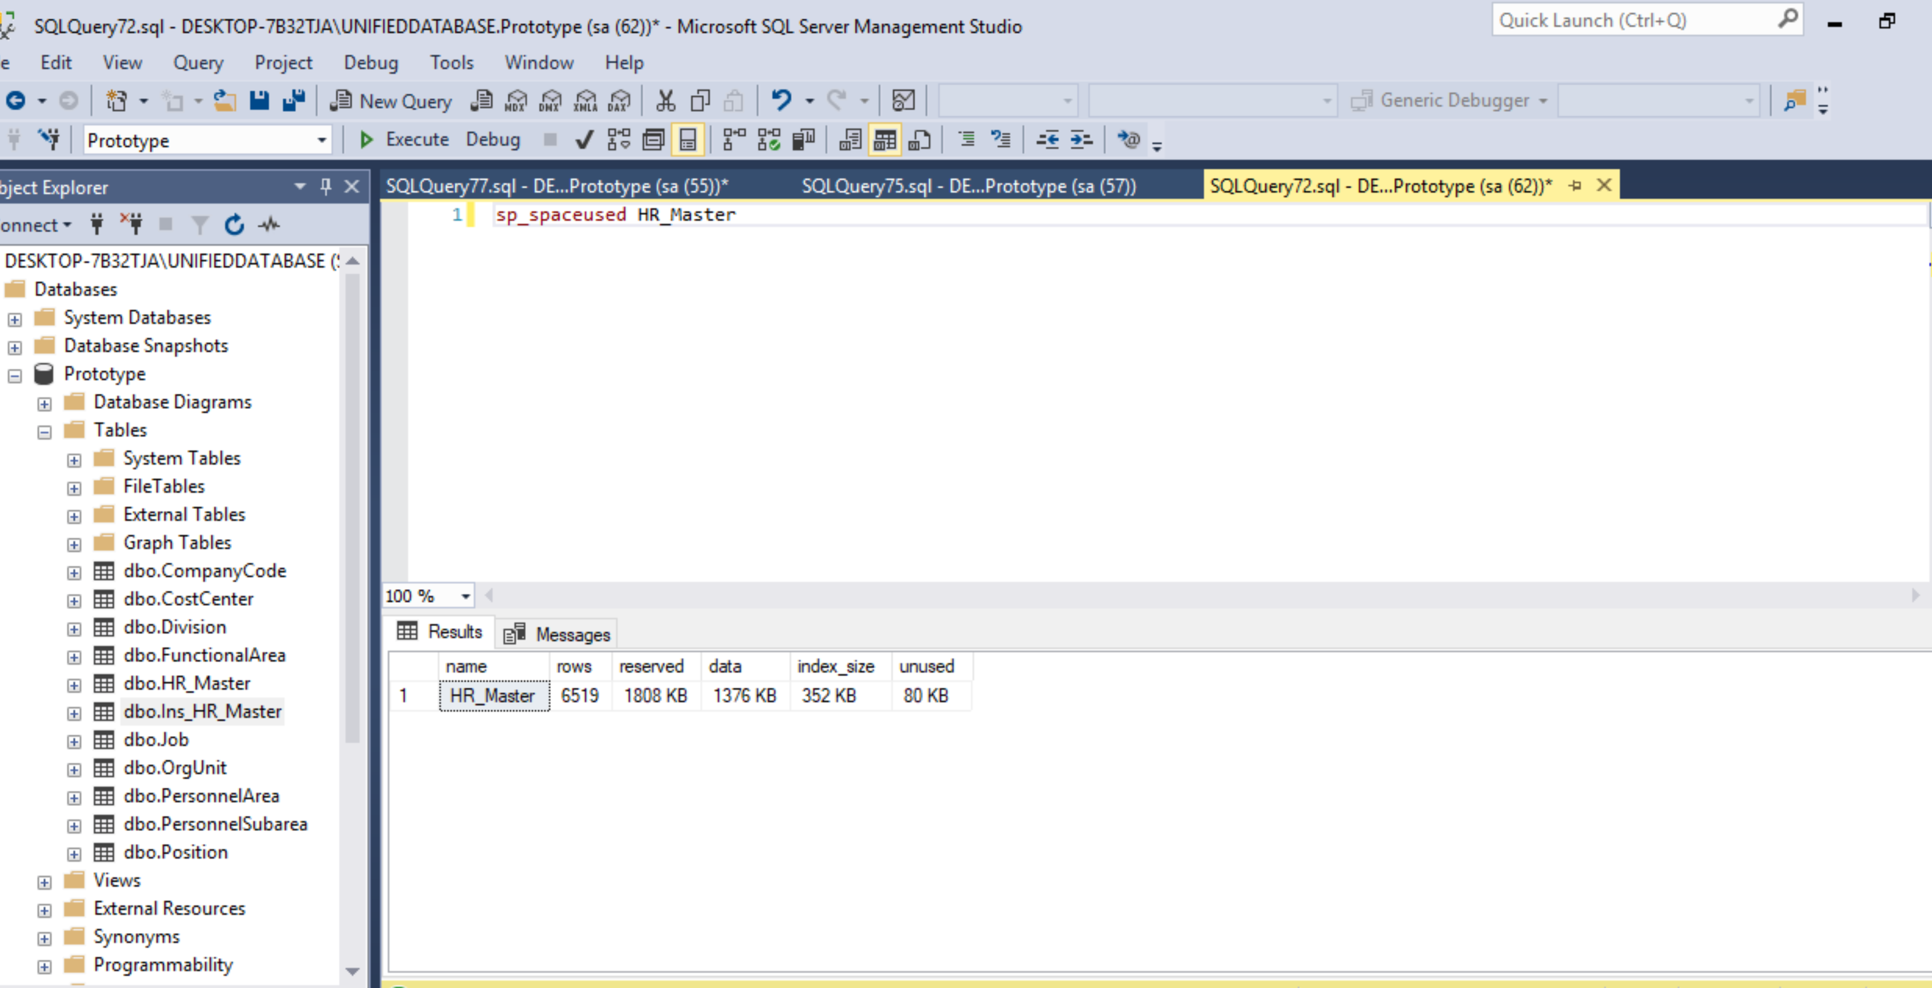

Slide 6
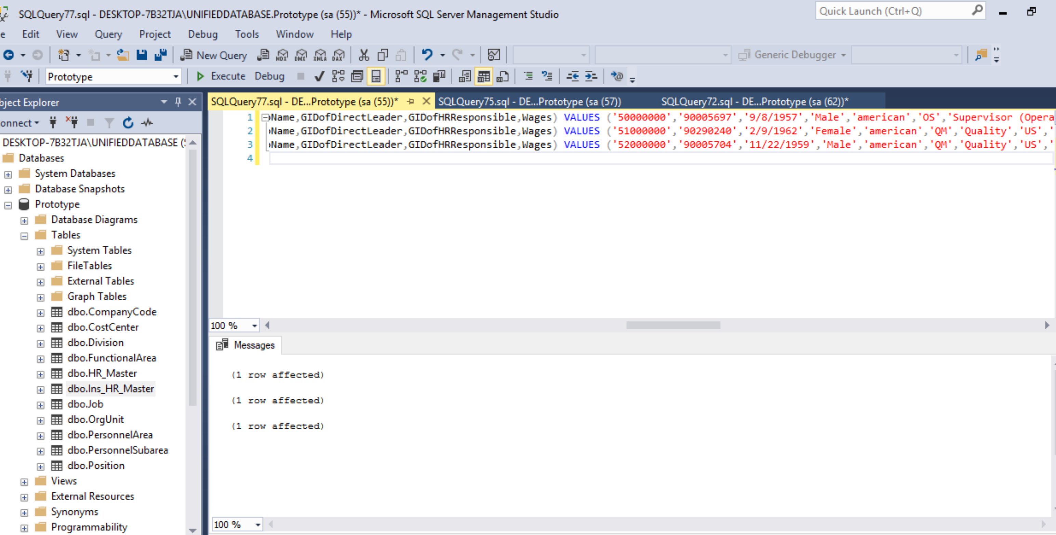

Slide 7
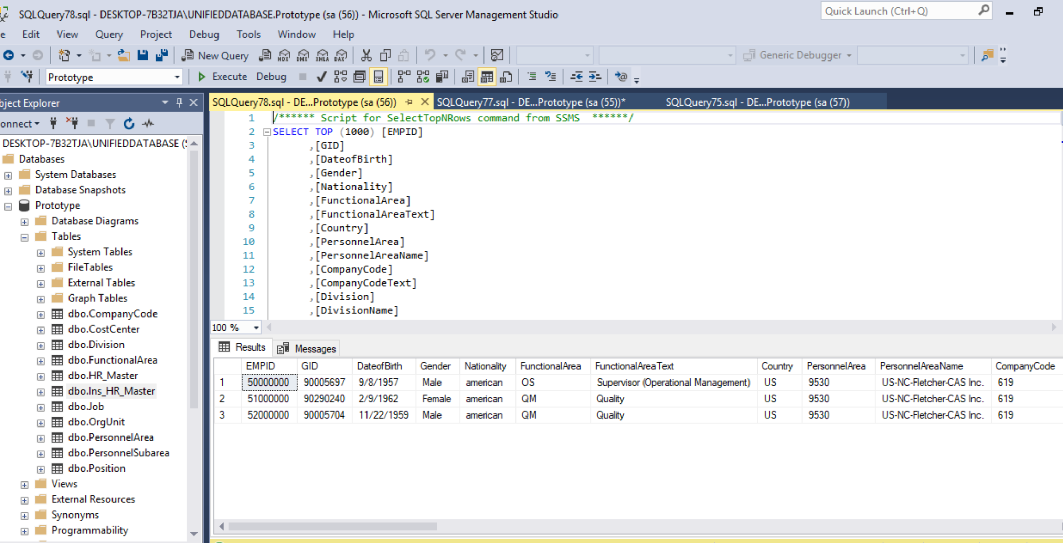

Slide 8
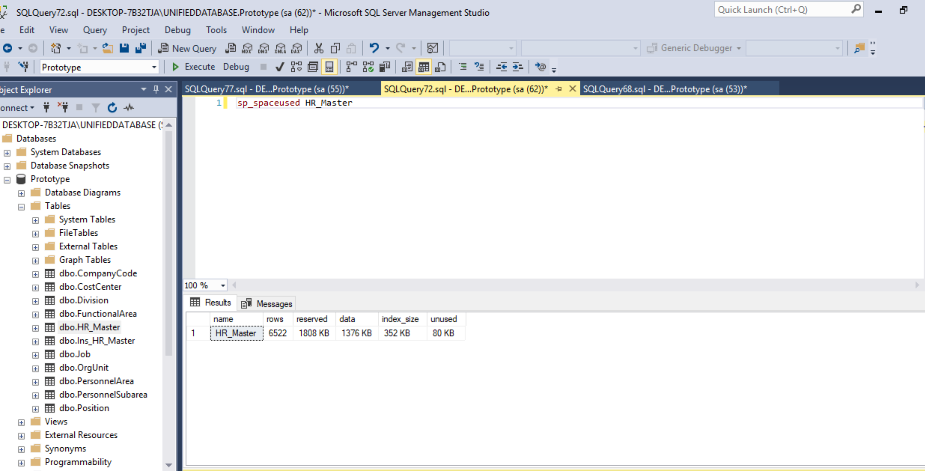

Slide 9
Test Case 2
Insert duplicate records in Ins_Hr_Master table.
Run program to insert and update proper record in Hr_Master table.
Check Hr_Master table.

Slide 10
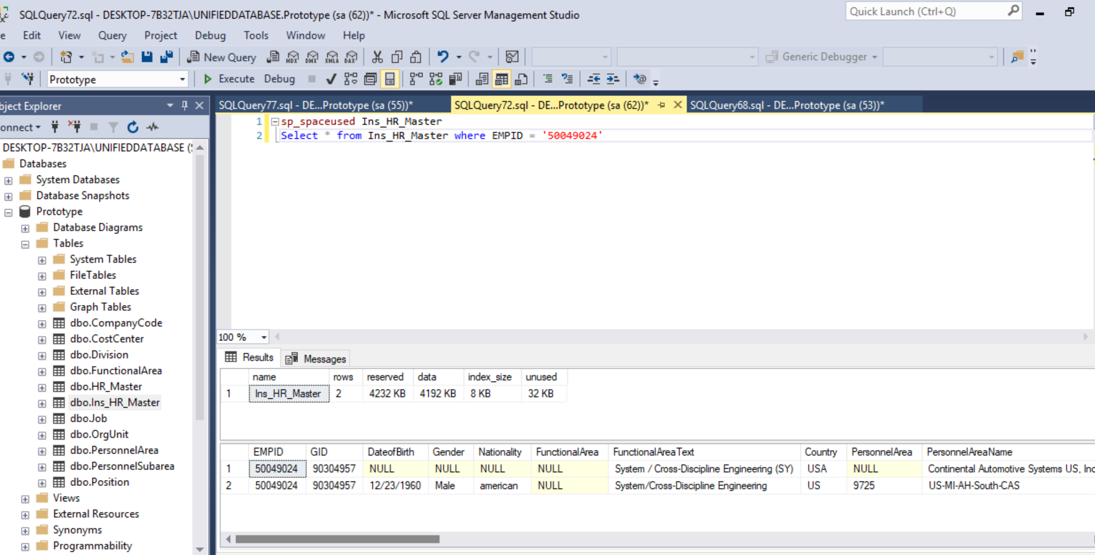

Slide 11
